Slide 1


Smart Charger
Team Name: THE DECIDERS
Team Members :
Balaji G
Balaji E
Britto A
Abdul Razaak S

Slide 2




1
Introduction
2
About the project
3
Objectives Of The Project
Index
4
Process
5
Conclusion

Slide 3

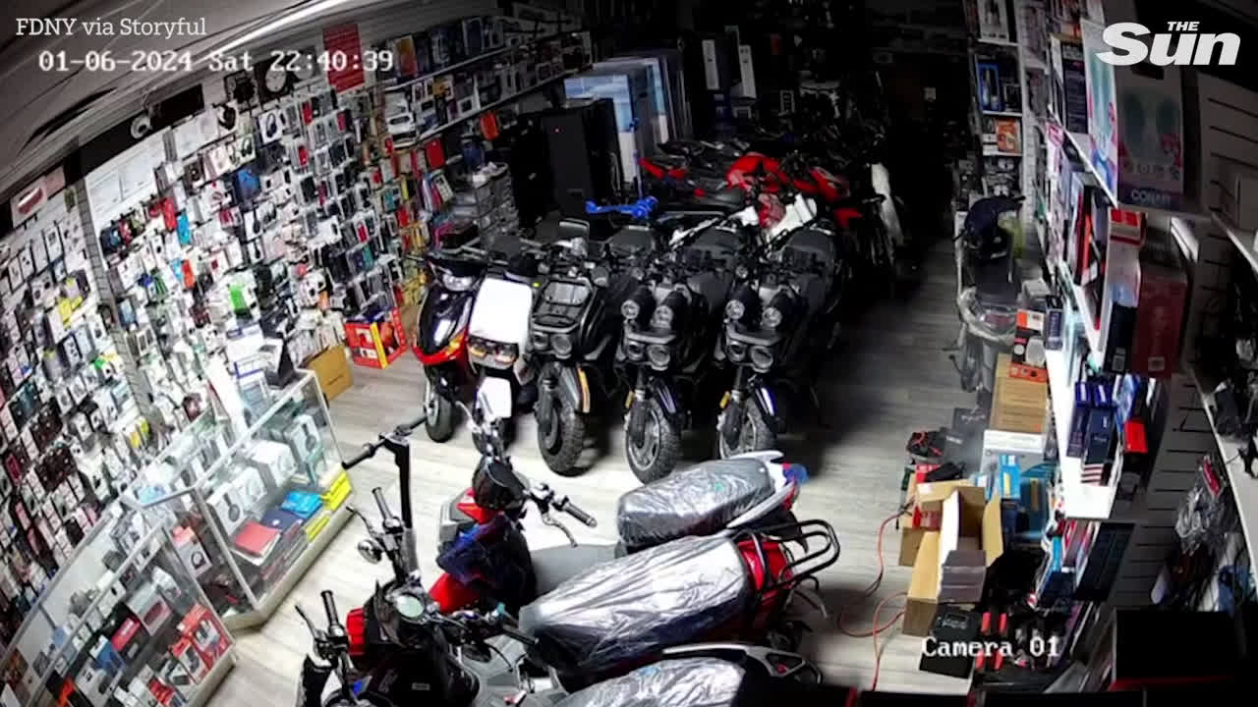


Problem statement
Video Credits :

